Slide 1
Power System Fault Detection and Classification
CAPSTONE PROJECT
Presented By:
Student Name-Devam Vinod Suryawanshi
College Name-MIT Academy Of Engineering
Department-Computer Engineering

Slide 2
OUTLINE
Problem Statement (Should not include solution)
Proposed System/Solution
System Development Approach (Technology Used)
Algorithm & Deployment
Result (Output Image)
Conclusion
Future Scope
References

Slide 3
Problem Statement
Electric power distribution networks often encounter various types of faults such as line-to-ground, line-to-line, and three-phase faults. Timely and precise identification of these faults is essential to reduce downtime and ensure the stability of the power grid. However, conventional protection mechanisms face challenges in accurately classifying faults in real time, particularly in complex or dynamic system conditions.

Slide 4
Proposed Solution
The proposed system uses machine learning techniques on IBM Cloud to classify faults in power distribution networks. It processes real-time electrical measurements (voltage and current phasors) to distinguish:
Normal conditions
Line-to-ground faults
Line-to-line faults
Three-phase faults
Key Components:
Data Collection (Phasor measurements)
Feature Extraction (Signal processing)
Model Training (ML algorithm)
Real-time Fault Classification
Cloud Deployment (IBM Cloud services)

Slide 5
System Approach
The "System Approach" section outlines the overall strategy and methodology for developing and implementing the Power system Fault Detection and Classification. Here's a suggested structure for this section:
System requirements
IBM Cloud
IBM Watson studio for model development and deployment
IBM cloud object storage for dataset handling

Slide 6
Algorithm & Deployment
Algorithm Selection:
Random Forest Classifier (or SVM based on performance)
Data Input:
Voltage, Current, and phasor measurments from the dataset
Training Process:
Supervised learning using labelled fault types
Prediction Process:
Model deployed on IBM watson studio with API endpoint for real-time predictions

Slide 7
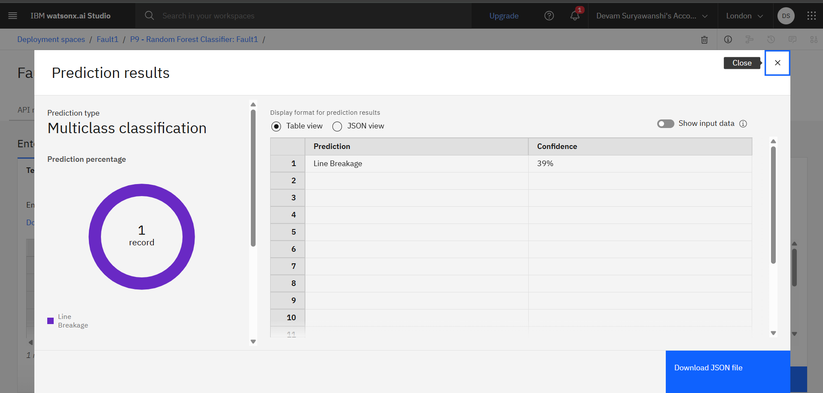
Result

Slide 8
Conclusion
The ML-based fault classification system significantly improves accuracy and response time over traditional protection methods. Real-time analysis helps utilities reduce outage time and improve grid resilience.

Slide 9
Github Link:
https://github.com/DevamSuryawanshi/Power-System-Fault-Detection-and-Classification/tree/main

Slide 10
Future scope
Expand to transmission grid faults
Integrate with real-time IoT sensor networks
Use deep learning models (e.g., LSTM) for better temporal pattern detection
Add predictive maintenance features

Slide 11
References
IEEE papers on power system fault detection
IBM Cloud documentation
Scikit-learn, TensorFlow libraries
Research on phasor measurement-based fault analysis

Slide 12
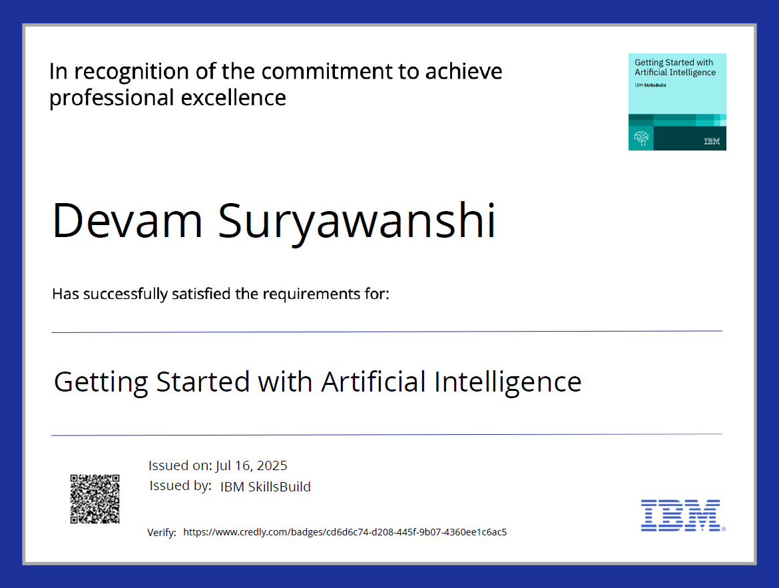
IBM Certifications

Slide 13
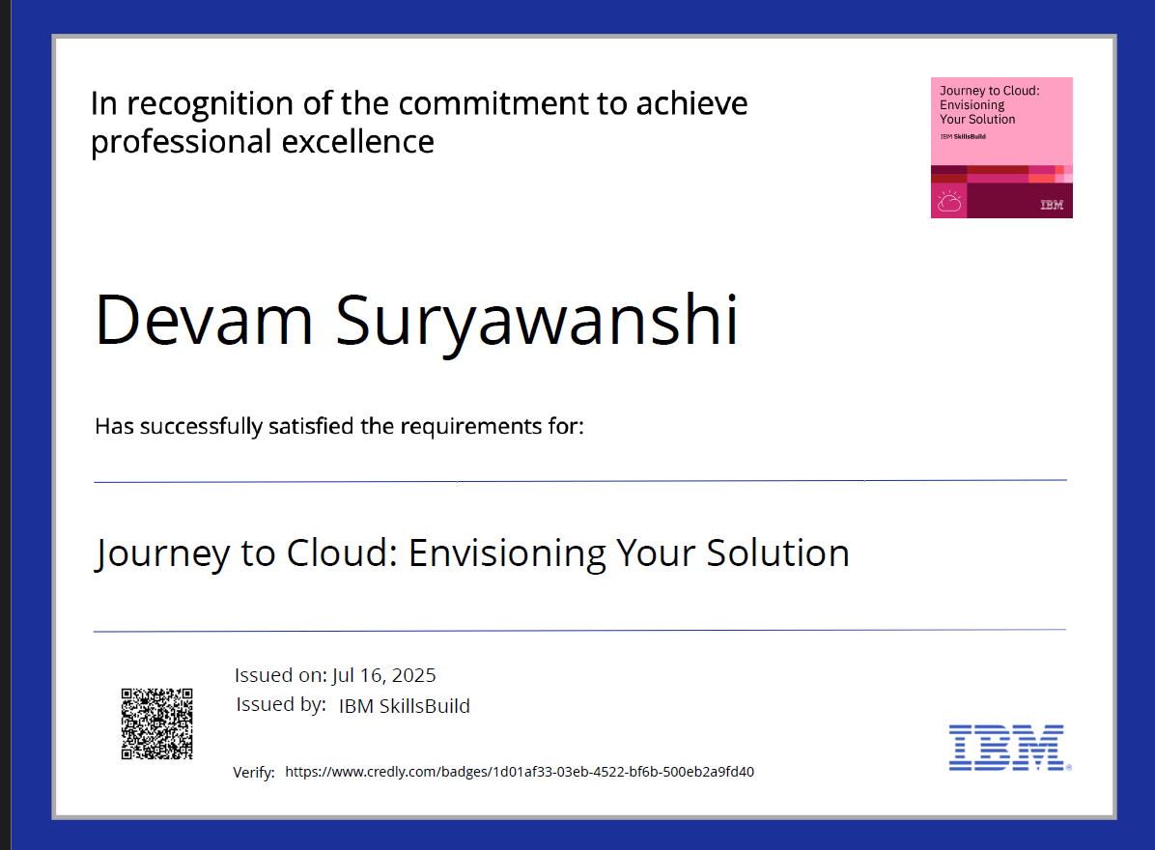
IBM Certifications

Slide 14
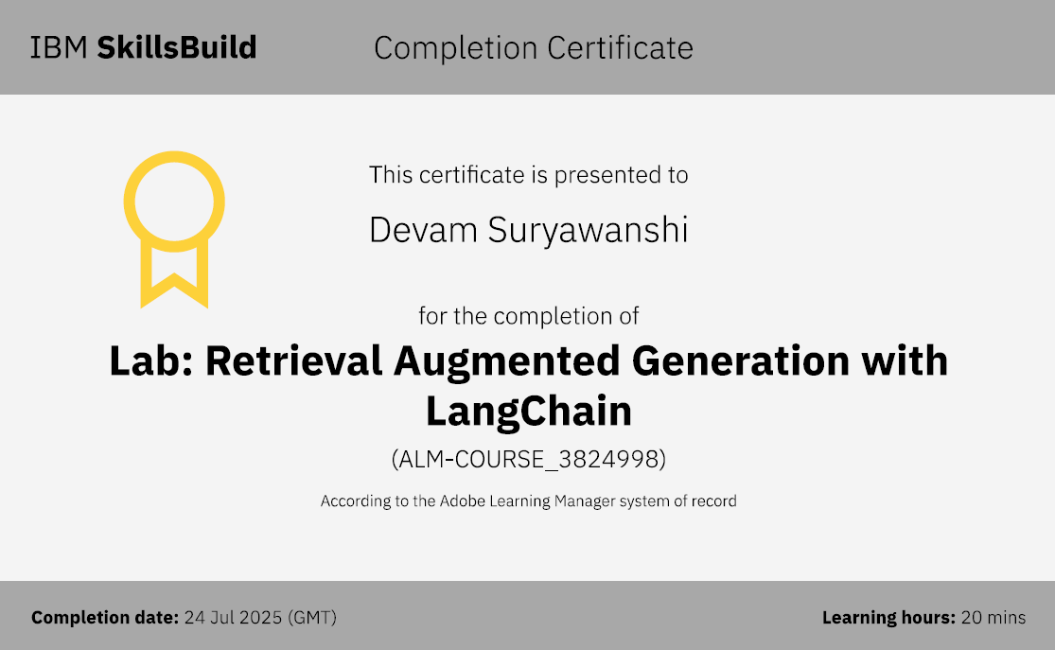
IBM Certifications

Slide 15
THANK YOU

